Slide 1


Introduction to Python
Author: Kishore Kumar
Email-ID: KishoreKumar_Netala@epam.com
JANUARY 4, 2018

Slide 2
Index
Day 1
Day 2
Brief History
What is Python
Features of Python
Installing & Running
Data Types
Control Flow
Loops
Functions
File Operations
Oops in Python
Modules
Packages
Install Packages with pip
Exception Handling
Python In Devops

Slide 3
Brief History
Invented in the Netherlands, early 90s by Guido van Rossum
Named after Monty Python's Flying Circus
Open sourced from the beginning
Considered a scripting language, but is much more
Scalable, object oriented and functional from the beginning

Slide 4
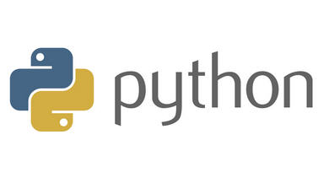
What is Python
Python is an interpreted, object-oriented, high-level programming language.
Its high-level built in data structures, combined with dynamic typing , make it very attractive for Rapid Application Development.

Slide 5
Features of Python
Simple and Easy to Learn.
Uses an elegant syntax, making the programs you write easier to read.
A variety of basic data types are available: numbers (floating point, complex, and unlimited-length long integers), strings (both ASCII and Unicode), lists, and dictionaries
Python contains advanced programming features such as generators and list comprehensions.
Python's automatic memory management frees you from having to manually allocate and free memory in your code
Lot of Python open source packages & modules

Slide 6
Installing & Running
Python is pre-installed on most Unix systems, including Linux and MAC OS X
Python Installers are available at python.org
Set Path variables to access python via CLI
Run python --version
There are several options for an IDE
IDLE – works well with Windows
Eclipse with PyDev
PyCharm

Slide 7
Data Types in Python
Integers (default for numbers)
z = 5 / 2 # Answer 2, integer division
Floats
x = 3.456
Strings
Can use “” or ‘’ to specify with “abc” == ‘abc’
Lists
list1 = [1, 2, ‘abc’]
Dictionaries
dict1 = {‘key1’:‘value1’, 2:‘2 value’}

Slide 8
Control Flow
if condition:
statements
elif condition:
statements
else:
statements
while condition:
statements
for var in sequence:
statements
break
continue

Slide 9
Loops
For Loop
The for statement is used to iterate over the elements of a sequence.
In For loop we can define the number of iterations.
The while loop tells the computer to do something as long as the condition is met.
The condition is evaluated, and if the condition is true, the code within the block is executed.
While Loop

Slide 10
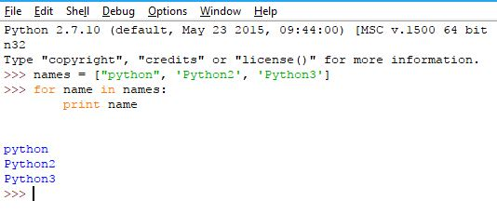
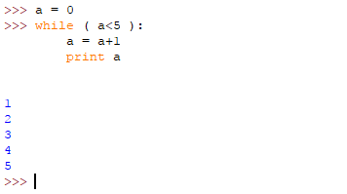
Loops

Slide 11
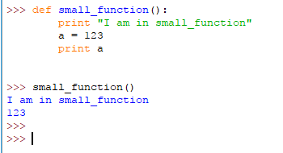
Functions
A function is a block of organized, reusable code that is used to perform a single, related action.
Functions provide better modularity for your application and a high degree of code reusing.

Slide 12
Operations on Data Types
Operations on numbers
Arithmetic, Comparison
String Manipulations in Python
Index, Search, Slicing
List Operations in Python
Index, Update, Search, Slicing
Manage Python Dictionaries
Keys, Update, membership

Slide 13
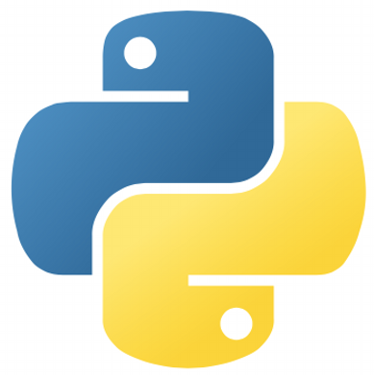
Thank You
References
https://www.python.org
https://www.python.org/downloads/
https://docs.python.org/2/

